Slide 1
Openshift Storage
Persistence Volume
Persistence Volume Claim
Storage Class

Slide 2
Persistence Volume

Slide 3
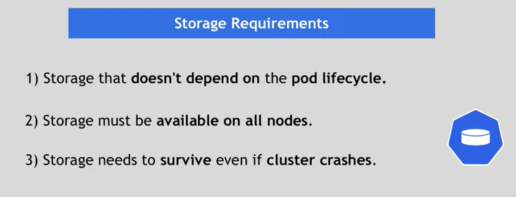
POD
Database

Slide 4
POD
POD
Database

Slide 5
NFS Storage - Yaml
Volume.yaml
apiVersion: v1
kind: PersistentVolume
metadata:
name: pv0001
spec:
capacity:
storage: 512Mi
accessModes:
- ReadWriteOnce
nfs:
path: /tmp
server: 172.17.0.2
persistentVolumeReclaimPolicy: Retain
Command –
Oc create –f volume.yaml

Slide 6
Persistence Volume Claim

Slide 7
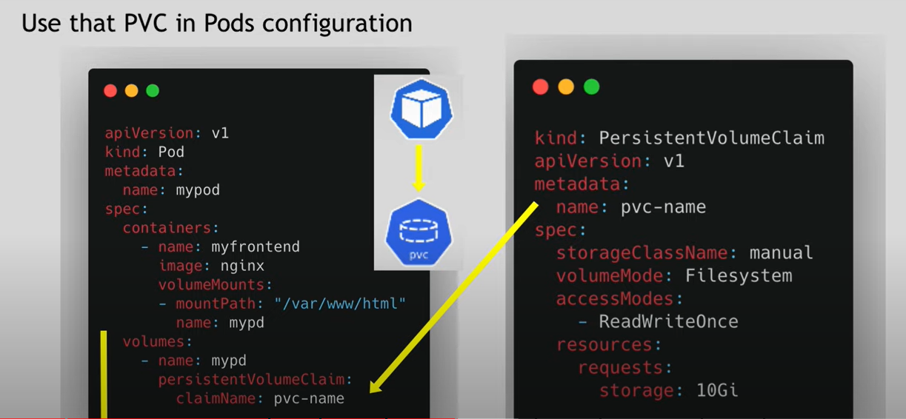

Slide 8
Storage Class

Slide 9
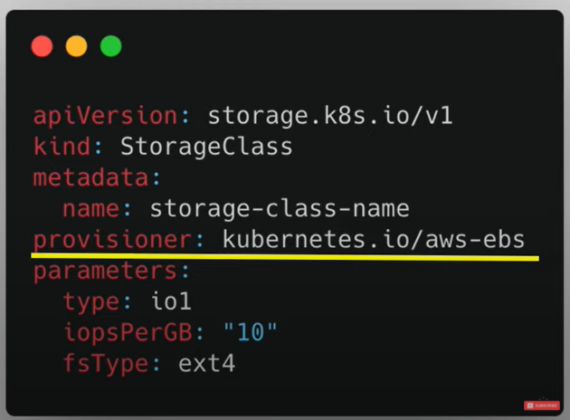
Storage Class

Slide 10
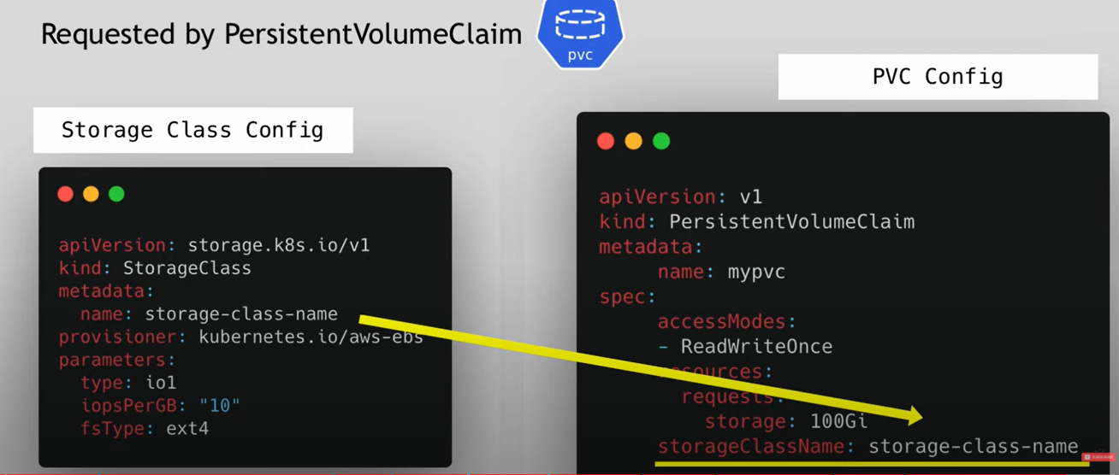

Slide 11
